Slide 1
Chapter 6
A Close Look at Classes and Methods
李晔锋

Slide 2
Key Skills & Concepts
Control access to members
Pass objects to a method
Return objects from a method
Overload methods
Overload constructors
Use recursion
Apply static
Use inner classes
Use varargs

Slide 3
Controlling Access to Class Members
In Java, there are two basic types of class members: public and private.
A public member can be freely accessed by code defined outside of its class.
A private member can be accessed only by other methods defined by its class.

Slide 4
Java’s Access Modifiers
Member access control is achieved through the use of three access modifiers: public, private, and protected. If no access modifier is used, the default access setting is assumed.
When a member of a class is modified by the public specifier, that member can be accessed by any other code in your program.
When a member of a class is specified as private, that member can be accessed only by other members of its class.
The default access setting is the same as public unless your program is broken down into packages (directories).

Slide 5
Simple Access Demo
class MyClass {
private int alpha; //private access
public int beta; //public access
int gamma; //default access
void setAlpha(int a) {
alpha = a;
}
int getAlpha() {
return alpha;
}
}
public class AccessDemo {
public static void main(String[] args) {
// TODO Auto-generated method stub
MyClass ob = new MyClass();
ob.setAlpha(-99);
System.out.println("Alpha is: " + ob.getAlpha());
//ob.alpah = 10; //Wrong! alpha is private
//These are OK because beta and gammar is public
ob.beta = 88;
ob.gamma = 99;
}
}

Slide 6
The Key Point of a Private Member
The key point is this: A private member can be used freely by other members of its class, but it cannot be accessed by code outside its class.

Slide 7
The Fail-Soft Array Demo
The demo implements an int array which prevents the index exceeding the boundary.
This is accomplished by encapsulating the array as a private member of a class, allowing access to the array only through member methods.

Slide 8
Pass Objects to Methods
class Block {
int a,b,c;
int volume;
Block(int i, int j, int k){
a = i;
b = j;
c = k;
volume = a * b * c;
}
boolean sameBlock(Block ob) {
if(ob.a==a && ob.b==b && ob.c==c)
return true;
else
return false;
}
boolean sameVolume(Block ob) {
if(ob.volume==volume) return true;
else return false;
}
}
public class PassOb {
public static void main(String[] args) {
// TODO Auto-generated method stub
Block ob1 = new Block(10,2,5);
Block ob2 = new Block(10,2,5);
Block ob3 = new Block(4,5,5);
System.out.println("ob1 same dimensions as ob2: " +
ob1.sameBlock(ob2));
System.out.println("ob1 same dimensions as ob3: " +
ob1.sameBlock(ob3));
System.out.println("ob1 same volume as ob3: " +
ob1.sameVolume(ob3));
}
}

Slide 9
How Arguments Are Passed
The first way is call-by-value. This approach copies the value of an argument into the formal parameter of the subroutine. Therefore, changes made to the parameter of the subroutine have no effect on the argument in the call.
The second way an argument can be passed is call-by-reference. Inside the subroutine, this reference is used to access the actual argument specified in the call. This means that changes made to the parameter will affect the argument used to call the subroutine.

Slide 10
Call-by-Value
When you pass a primitive type, such as int or double, to a method, it is passed by value. Thus, a copy of the argument is made, and what occurs to the parameter that receives the argument has no effect outside the method.

Slide 11
public class Test {
void noChange(int i, int j) {
i = i + j;
j = -j;
}
}
public class CallByValue {
public static void main(String[] args) {
// TODO Auto-generated method stub
Test ob = new Test();
int a = 15, b = 20;
System.out.println("a and b before call: " +
a + " " + b);
ob.noChange(a, b);
System.out.println("a and b after call: " +
a + " " + b);
}
}

Slide 12
Call-by-Value
Test ob = new Test();
int a = 15, b = 20;
void noChange(int i, int j) {
i = i + j;
j = -j;
}
ob.noChange(a, b);
The change of parameters does not affect the arguments.
Memory
a
15
15
i
35
j
20
b
20
-20

Slide 13
Call-by-Reference
When you pass this reference to a method, the parameter that receives it will refer to the same object as that referred to by the argument.

Slide 14
public class Test {
int a,b;
Test(int i, int j){
a = i;
b = j;
}
void change(Test ob) {
ob.a = ob.a + ob.b;
ob.b = -ob.b;
}
}
public class PassObRef {
public static void main(String[] args) {
// TODO Auto-generated method stub
Test ob = new Test(15,20);
System.out.println("ob.a and ob.b before call: " +
ob.a + " " + ob.b);
ob.change(ob);
System.out.println("ob.a and ob.b after call: " +
ob.a + " " + ob.b);
}
}

Slide 15
Call-by-Reference
Test ob = new Test(15,20);
void change(Test ob) {
ob.a = ob.a + ob.b;
ob.b = -ob.b;
}
ob.change(ob);
Memory
a
ob
15
35
object
b
ob
20
-20

Slide 16
Returning Objects
A method can return any type of data, including class types.
When an object is returned by a method, it remains in existence until there are no more references to it.
public class ErrorMsg {
String msgs[]= {"Output Error","Input Error",
"Disk Full","Index Out-Of-Bounds"};
String getErrorMsg(int i) {
if(i >= 0 && i < msgs.length)
return msgs[i];
else
return "Invalid Error Code";
}
}
public class ErrMsg {
public static void main(String[] args) {
// TODO Auto-generated method stub
ErrorMsg err = new ErrorMsg();
System.out.println(err.getErrorMsg(2));
System.out.println(err.getErrorMsg(19));
}
}

Slide 17
Method Overloading（重载）
In Java, two or more methods within the same class can share the same name, as long as their parameter declarations are different. When this is the case, the methods are said to be overloaded, and the process is referred to as method overloading.
The difference of parameter declaration including
Number of parameters
Data type of each parameter
The return type of the method may be different, but not sufficient.

Slide 18
public class Overload {
void ovlDemo() {
System.out.println("No parameters");
}
void ovlDemo(int a) {
System.out.println("One parameter: " + a);
}
int ovlDemo(int a, int b) {
System.out.println("Two parameters: " + a + " " + b);
return a+b;
}
double ovlDemo(double a,double b) {
System.out.println("Two double parameters: " + a + " " + b);
return a+b;
}
}

Slide 19
public class OverloadDemo {
public static void main(String[] args) {
// TODO Auto-generated method stub
Overload ob = new Overload();
int resI;
double resD;
ob.ovlDemo();
System.out.println();
ob.ovlDemo(2);
System.out.println();
resI = ob.ovlDemo(4, 6);
System.out.println("Result of the above is : " + resI);
System.out.println();
resD = ob.ovlDemo(1.1, 2.32);
System.out.println("Result of the above is: " + resD);
}
}

Slide 20
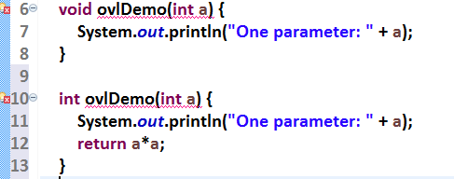
The following is not allowed

Slide 21
public class Overload2 {
void f(int x) {
System.out.println("Inside f(int): " + x);
}
void f(double x) {
System.out.println("Inside f(double): " + x);
}
}
public class TypeConv {
public static void main(String[] args) {
// TODO Auto-generated method stub
Overload2 ob = new Overload2();
int i = 10;
double d = 10.1;
byte b = 99;
short s = 10;
float f = 11.5F;
ob.f(i);
ob.f(d);
ob.f(b);
ob.f(s);
ob.f(f);
}
}

Slide 22
Overloading Constructors
Like methods, constructors can also be overloaded. Doing so allows you to construct objects in a variety of ways.

Slide 23
public class MyClass {
int x;
MyClass(){
System.out.println("Inside MyClass()");
x = 0;
}
MyClass(int i){
System.out.println("Inside MyClass(int).");
x = i;
}
MyClass(double d){
System.out.println("Inside MyClass(double).");
x = (int)d;
}
MyClass(int i, int j){
System.out.println("Inside MyClass(int,int");
x = i * j;
}
}
public class OverloadConsDemo {
public static void main(String[] args) {
// TODO Auto-generated method stub
MyClass t1 = new MyClass();
MyClass t2 = new MyClass(88);
MyClass t3 = new MyClass(17.23);
MyClass t4 = new MyClass(2,4);
System.out.println("t1.x: " + t1.x);
System.out.println("t2.x: " + t2.x);
System.out.println("t3.x: " + t3.x);
System.out.println("t4.x: " + t4.x);
}
}

Slide 24
public class Summation {
int sum;
Summation(int num){
sum = 0;
for(int i = 1; i <= num; i++)
sum += i;
}
Summation(Summation ob){
sum = ob.sum;
}
}
public class SumDemo {
public static void main(String[] args) {
// TODO Auto-generated method stub
Summation s1 = new Summation(5);
Summation s2 = new Summation(s1);
System.out.println("s1.sum: " + s1.sum);
System.out.println("s2.sum: " + s2.sum);
}
}

Slide 25
Recursion（递归）
In Java, a method can call itself. This process is called recursion, and a method that calls itself is said to be recursive.

Slide 26
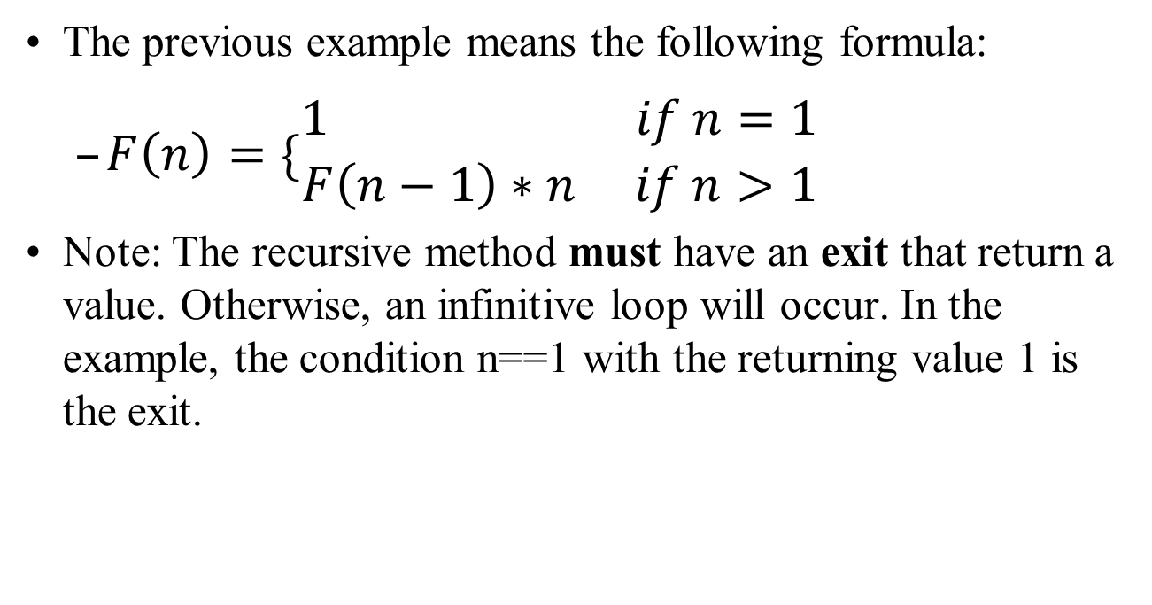
Recursion（递归）
The previous example means the following formula:
$F\left(n\right)=\{\begin{matrix}1 if n=1 \\ F\left(n−1\right)∗n if n>1\end{matrix}$
Note: The recursive method must have an exit that return a value. Otherwise, an infinitive loop will occur. In the example, the condition n==1 with the returning value 1 is the exit.

Slide 27
public class Factorial {
int factR(int n) {
int result;
if(n == 1) return 1;
result = factR(n-1)*n;
return result;
}
int factI(int n) {
int t, result;
result = 1;
for(t=1;t<=n;t++)
result *= t;
return result;
}
}
public class Recursion {
public static void main(String[] args) {
// TODO Auto-generated method stub
Factorial f = new Factorial();
System.out.println("Factorials using recursive method.");
System.out.println("Factorial of 3 is " + f.factR(3));
System.out.println("Factorial of 4 is " + f.factR(4));
System.out.println("Factorial of 5 is " + f.factR(5));
System.out.println();
System.out.println("Factorials using iterative method.");
System.out.println("Factorial of 3 is " + f.factI(3));
System.out.println("Factorial of 4 is " + f.factI(4));
System.out.println("Factorial of 5 is " + f.factI(5));
}
}

Slide 28
Understanding static
When a member is declared static, it can be accessed before any objects of its class are created, and without reference to any object. You can declare both methods and variables to be static.
Outside the class, to use a static member, you need only specify the name of its class followed by the dot operator. No object needs to be created. For example, if you want to assign the value 10 to a static variable called count that is part of the Timer class, use this line:
Timer.count = 10;

Slide 29
public class StaticDemo {
int x;
static int y;
int sum() {
return x + y;
}
}
public class SDemo {
public static void main(String[] args) {
// TODO Auto-generated method stub
StaticDemo ob1 = new StaticDemo();
StaticDemo ob2 = new StaticDemo();
//Each object has its own object
ob1.x = 10;
ob2.x = 20;
System.out.println("ob1.x=" + ob1.x);
System.out.println("ob2.x=" + ob2.x);
System.out.println();
//Change ob1.y to 19
ob1.y = 19;
System.out.println("ob2.y=" + ob2.y);
System.out.println();
//Change y to 100
StaticDemo.y = 100;
System.out.println("ob1.sum(): " + ob1.sum());
System.out.println("ob2.sum(): " + ob2.sum());
}
}

Slide 30
Static Variable
public class StaticDemo {
int x;
static int y;
int sum() {
return x + y;
}
}
Memory
x
x
10
20
y
ob1
19
ob2

Slide 31
Static Method
The static method is called through its class name, without any object of that class being created.
public class StaticMeth {
static int val = 1024;
static int valDiv2() {
return val/2;
}
}
public class SDemo2 {
public static void main(String[] args) {
// TODO Auto-generated method stub
System.out.println("val is " + StaticMeth.val);
System.out.println("StaticMeth.valDiv2(): " +
StaticMeth.valDiv2());
StaticMeth.val = 4;
System.out.println("val is " + StaticMeth.val);
System.out.println("StaticMeth.valDiv2(): " +
StaticMeth.valDiv2());
}
}

Slide 32
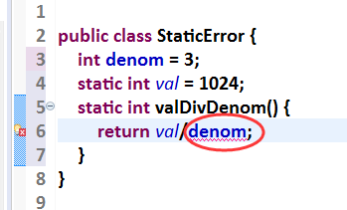
Static Method Restrictions
Methods declared as static have several restrictions:
They can directly call only other static methods in their class.
They can directly access only static variables in their class.
They do not have a this reference.

Slide 33
Static Blocks
Sometimes a class will require some type of initialization before it is ready to create objects. To handle these types of situations, Java allows you to declare a static block. A static block is executed when the class is first loaded.
public class StaticBlock {
static double rootOf2;
static double rootOf3;
static {
System.out.println("Inside static block.");
rootOf2 = Math.sqrt(2.0);
rootOf3 = Math.sqrt(3.0);
}
StaticBlock(String msg){
System.out.println(msg);
}
}
public class SDemo3 {
public static void main(String[] args) {
// TODO Auto-generated method stub
StaticBlock ob = new StaticBlock("Inside Constructor");
System.out.println("Square root of 2 is " +
StaticBlock.rootOf2);
System.out.println("Square root of 3 is " +
StaticBlock.rootOf3);
}
}

Slide 34
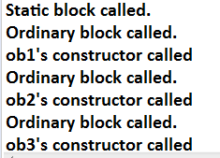
Initializing Sequence
public class MyClass {
String name;
static {
System.out.println("Static block called.");
}
{
System.out.println("Ordinary block called.");
}
MyClass(String name){
this.name = name;
System.out.println(name + "'s constructor called");
}
}
public class SDemo4 {
public static void main(String[] args) {
// TODO Auto-generated method stub
MyClass ob1 = new MyClass("ob1");
MyClass ob2 = new MyClass("ob2");
MyClass ob3 = new MyClass("ob3");
}
}

Slide 35
Introducing Nested and Inner Classes
In Java, you can define a nested class. This is a class that is declared within another class.
There are two general types of nested classes: those that are preceded by the static modifier and those that are not.
The only type that we are concerned about is the non-static variety. This type of nested class is also called an inner class. It has access to all of the variables and methods of its outer class and may refer to them directly in the same way that other non-static members of the outer class do.

Slide 36
Varargs: Variable-Length Arguments
A method that takes a variable number of arguments is called a variable-arity method, or simply a varargs method. The parameter list for a varargs method is not fixed, but rather variable in length. Thus, a varargs method can take a variable number of arguments.

Slide 37
Varargs Basics
A variable-length argument is specified by three periods (...).
public class VarArgs {
static void vaTest(int ... v) {
System.out.println("Number of args: "+ v.length);
System.out.println("Contents: ");
for(int i = 0; i < v.length; i++)
System.out.println(" arg " + i + ": " + v[i]);
System.out.println();
}
public static void main(String[] args) {
// TODO Auto-generated method stub
vaTest(10);
vaTest(1,2,3);
vaTest();
}
}

Slide 38
Varargs with Normal Parameters
A method can have “normal” parameters along with a variable-length parameter. However, the variable-length parameter must be the last parameter declared by the method.

Slide 39
Varargs with Normal Parameters
public class VarArgs2 {
static void vaTest(String msg, int ... v) {
System.out.println(msg + v.length);
System.out.println("Contents: ");
for(int i = 0; i < v.length; i++)
System.out.println(" arg " + i + ": " + v[i]);
System.out.println();
}
public static void main(String[] args) {
// TODO Auto-generated method stub
vaTest("One vararg: ",10);
vaTest("Three varargs: ",1,2,3);
vaTest("No varargs:");
}
}

Slide 40
Overloading Varargs Methods
There are two ways that varargs can be overloaded:
First, the types of its vararg parameter can differ.
The second way to overload a varargs method is to add one or more normal parameters.

Slide 41
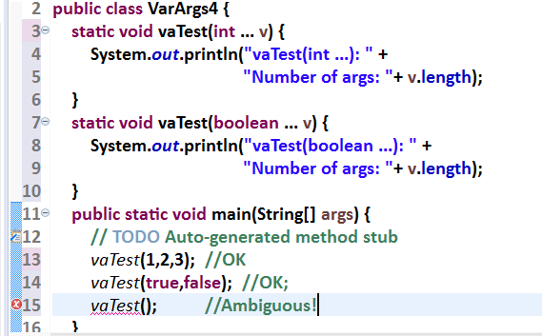
Varargs and Ambiguity（二义性）
Somewhat unexpected errors can result when overloading a method that takes a variable-length argument. These errors involve ambiguity because it is possible to create an ambiguous call to an overloaded varargs method.

